Slide 1

Title of Presentation
PRESENTED BY
First Person, Title
Second Person, Title
Third Person, Title
December 14, 2021

Slide 2

Title of Presentation
PRESENTED BY
First Person, Title
Second Person, Title
Third Person, Title
December 14, 2021

Slide 3
U N I V E R S I T Y O F S O U T H A L A B A M A
Overview
This is the introductory paragraph describing what the presentation will be about. This copy should be brief and not get too far into the weeds. The recommended length of the paragraph is three to five sentences. It could be accompanied by short bullet points that outline the presentation to come. It helps to space out the bullet points and include color.
Bullet point one talks about the first section.
Bullet point two talks about the second section.
And bullet point three talks about the third section.

Slide 4
U N I V E R S I T Y O F S O U T H A L A B A M A
Text Slide
Short intro, then bullets. Keep text this size. If text won’t fit at this size, break up into multiple slides.
Bullet point one talks about the first section.
Bullet point two talks about the second section.
And bullet point three talks about the third section.

Slide 5
U N I V E R S I T Y O F S O U T H A L A B A M A
Text Slide When Bullets are Wordy
This is all one bullet point. The text is lengthy and multiple sentences. When you are trying to convey an idea that requires many words, it’s better to break up the bullets into multiple slides than to make the text smaller and add all bullets to one page. Small text is hard to read, and when the viewer is trying to read small text, they aren’t paying attention to you.

Slide 6
U N I V E R S I T Y O F S O U T H A L A B A M A
Section Divider
This page could be used to summarize previous slides or to introduce a new concept. It should be succinct.

Slide 7

Image Slide 1
This slide is for use when you have an image or a chart. A small amount of text can go here, while the photo or chart takes up the right side.

Slide 8
U N I V E R S I T Y O F S O U T H A L A B A M A
Image Slide 2
This slide is for use when you have an image or a chart. A small amount of text can go here, while the photo or chart takes up the right side.

Slide 9

Image Slide Use this format when you have a horizontal image. If cutline isn’t needed, delete this box.

Slide 10

Image Slide Cutline box can change shape to work with photo composition or size of cutline.

Slide 11

Image Slide Position of cutline can change to work better with the photo composition.

Slide 12
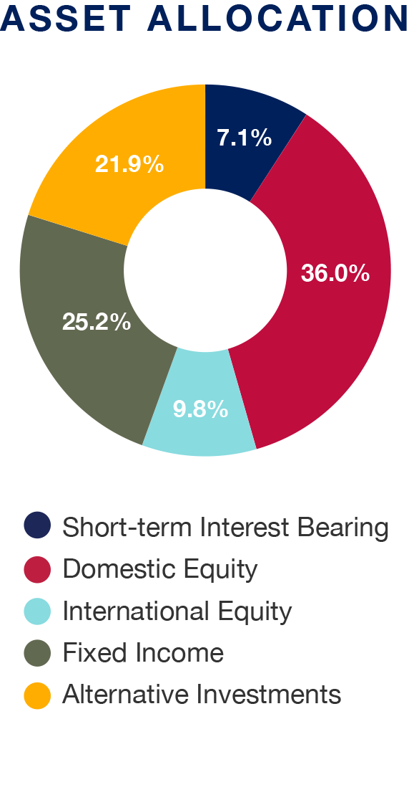
Image Slide
This slide is for use when you have an image or a chart. A small amount of text can go here, while the photo or chart takes up the right side.

Slide 13
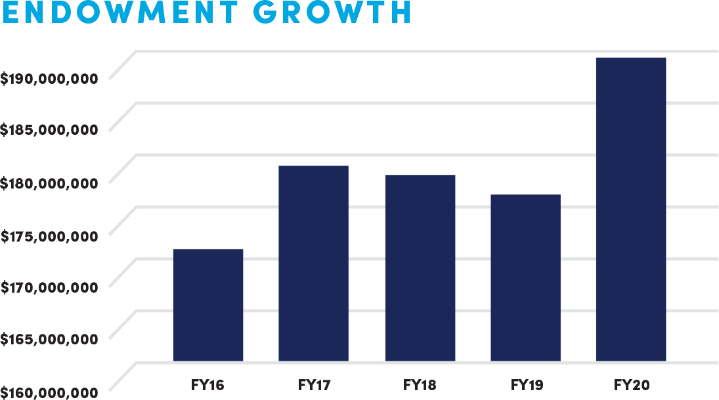
U N I V E R S I T Y O F S O U T H A L A B A M A
Bigger Chart

Slide 14
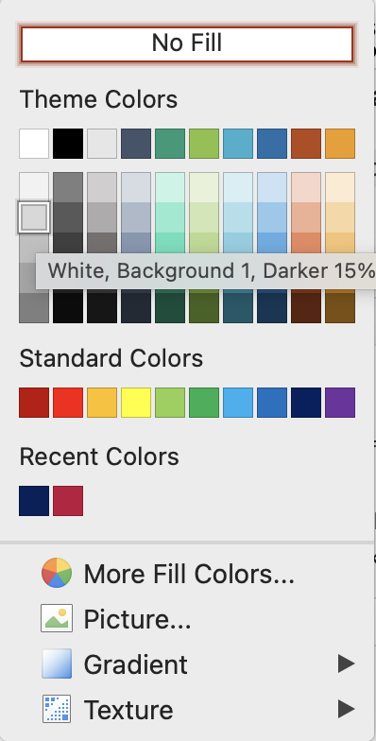
U N I V E R S I T Y O F S O U T H A L A B A M A
Design Specifications
Header font: Helvetica Bold, 36 point
Text font: Helvetica Light, 24 point
Colors: USA Blue, USA Red, Light Gray
Secondary palette may be used in charts.

